Slide 1

Building and Securing a Small Network

Slide 2
Team Members:
Mohamed Abdullah Mohamed – Week 1: Network Design and Configuration
Mohamed Fathy Abdel Hameed Mohamed – Week 2: VLANs and Inter-VLAN Routing
Mohanad Ashraf Ahmed – Week 3: Network Security Implementation
Joseph Wageeh Gerges Wanees – Week 4: Reporting
Tarek Yahia Atef – Final Testing
Kyrillos Sabry Nazim Nazmy– Weekly results validation and monitoring

Slide 3
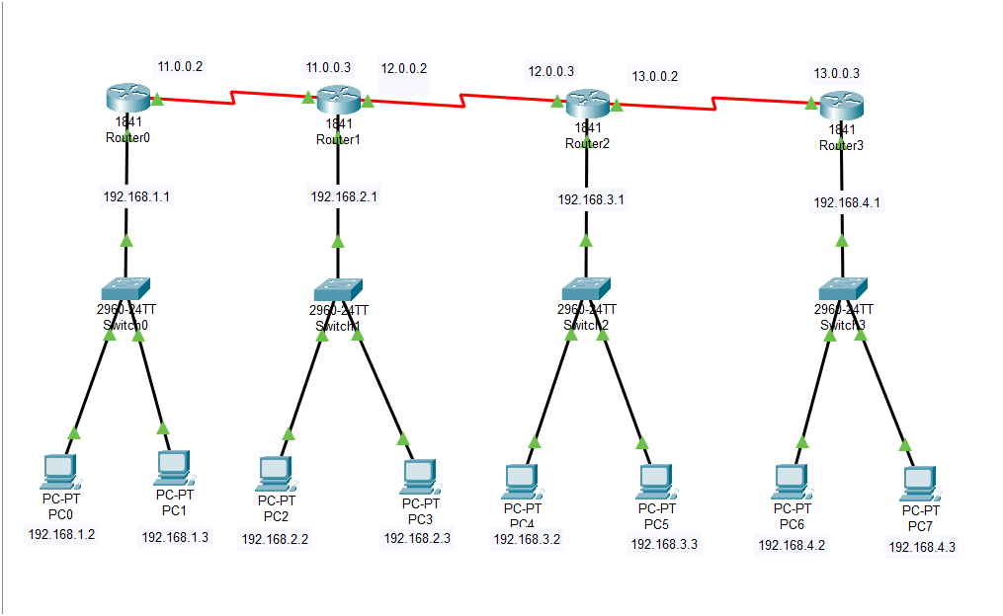
Project Overview
Project Title: Building and Securing a Small Network
Scope:
Design, configure, and secure a small network using Cisco devices.
Focus on VLANs, inter-VLAN routing, and network security.
Key Technologies:
Cisco routers and switches
VLAN segmentation and inter-VLAN routing
Security protocols (ACLs, firewalls)
Objectives:
Isolate network segments with VLANs and secure communication between them.
Protect the network using security measures.

Slide 4
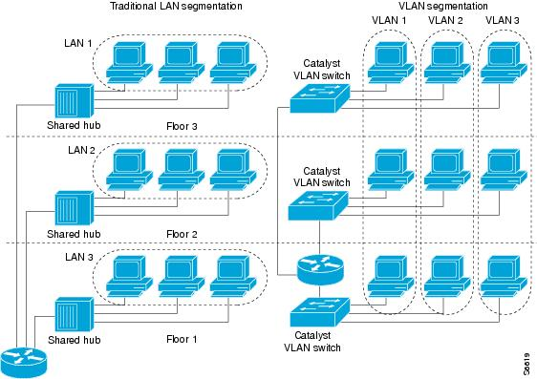
Network Topology & Design
Design:
Implemented a small network with VLANs for departmental segmentation.
Used a hierarchical IP addressing scheme for scalability.
Key Components:
Cisco routers and switches
VLANs and inter-VLAN routing
Scalable and flexible network topology

Slide 5
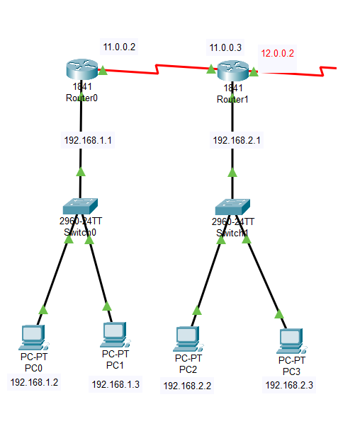
Week 1 – Network Design & Configuration
Objective:
Design the network and configure devices.
Assign IP addresses and set up basic connectivity.
Deliverables:
Network design diagram
IP address plan
Device configuration scripts

Slide 6
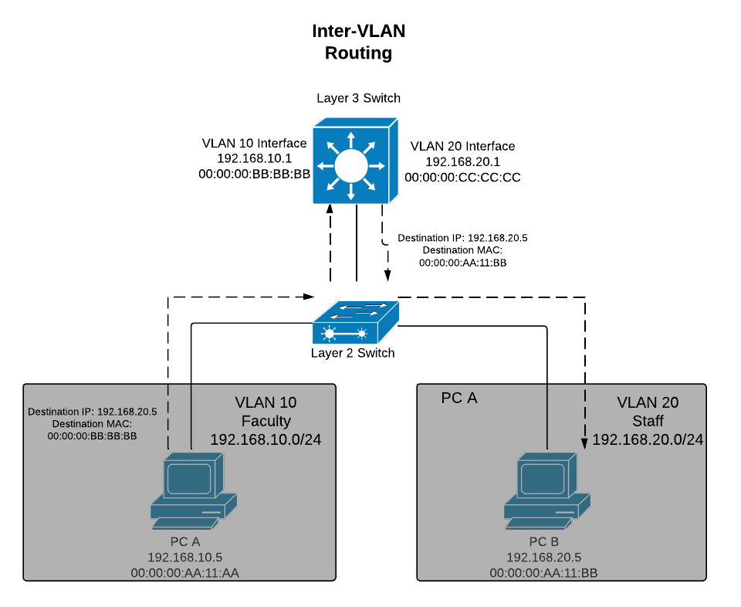
Week 2 – VLANs and Inter-VLAN Routing
Objective:
Set up VLANs and configure inter-VLAN routing to enable communication between network segments.
Deliverables:
VLAN configuration
Inter-VLAN routing setup
Troubleshooting report

Slide 7
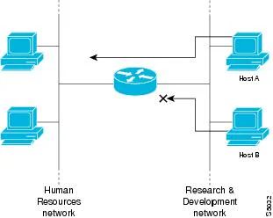
Network Security Implementation
Objective:
Secure the network using port security, ACLs, and firewall rules.
Deliverables:
Security settings (ACLs, firewall, port security)
Test results ensuring network protection

Slide 8
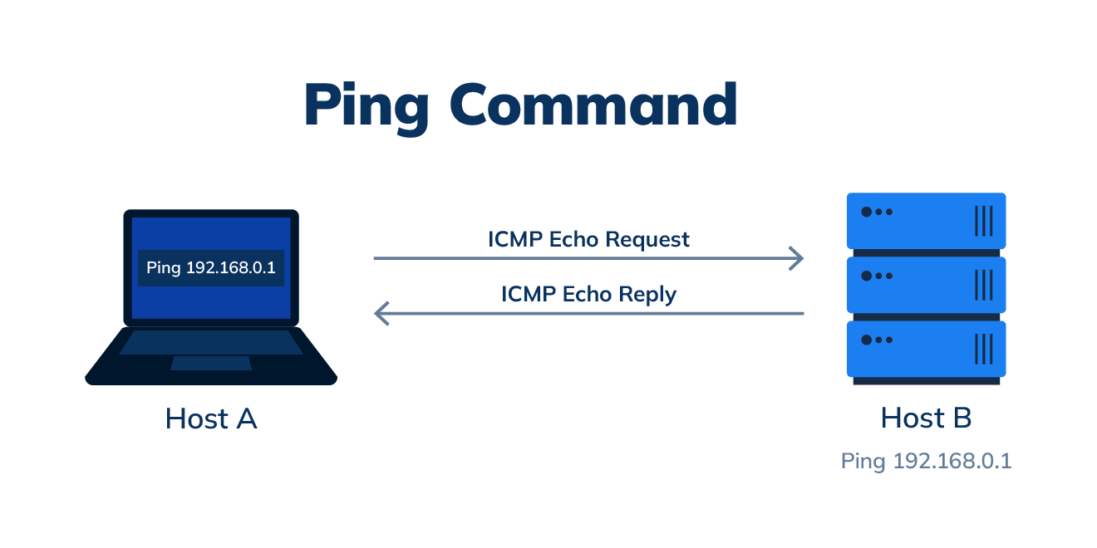
Week 4 – Final Testing & Reporting
Objective:
Test network performance and security.
Finalize the report and presentation.
Deliverables:
Test results summary
Final report and presentation

Slide 9

Conclusion & Recommendations
Conclusion:
The project successfully met the design and security goals.
All tests passed.
Recommendations:
Consider advanced security measures and continuous monitoring for future improvements.

Slide 10

Thank you

